Slide 1

Wprowadzenie do Interactive Queries dla rozwiązań Big Data
Katowice 2018.09.27
Authors:
Tomasz Krawczyk
Sebastian Zęderowski

Slide 2

?

Slide 3
Agenda
Real challenge vs Theory
Real challenge – possible solutions
HBase + Phoenix
Spark SQL
Hive LLAP

Slide 4
163 Zetta bytes by 2025
163 Zetta bytes =
163 000 000 000 000 000 000 000 bytes
163 *2⁷⁰ bytes 163 * 1024⁷ bytes
If 1 bytes = One grain of rice
then Zetta byte = Fills the Pacific Ocean
Watching the Netflix catalog
489 million times

Slide 5
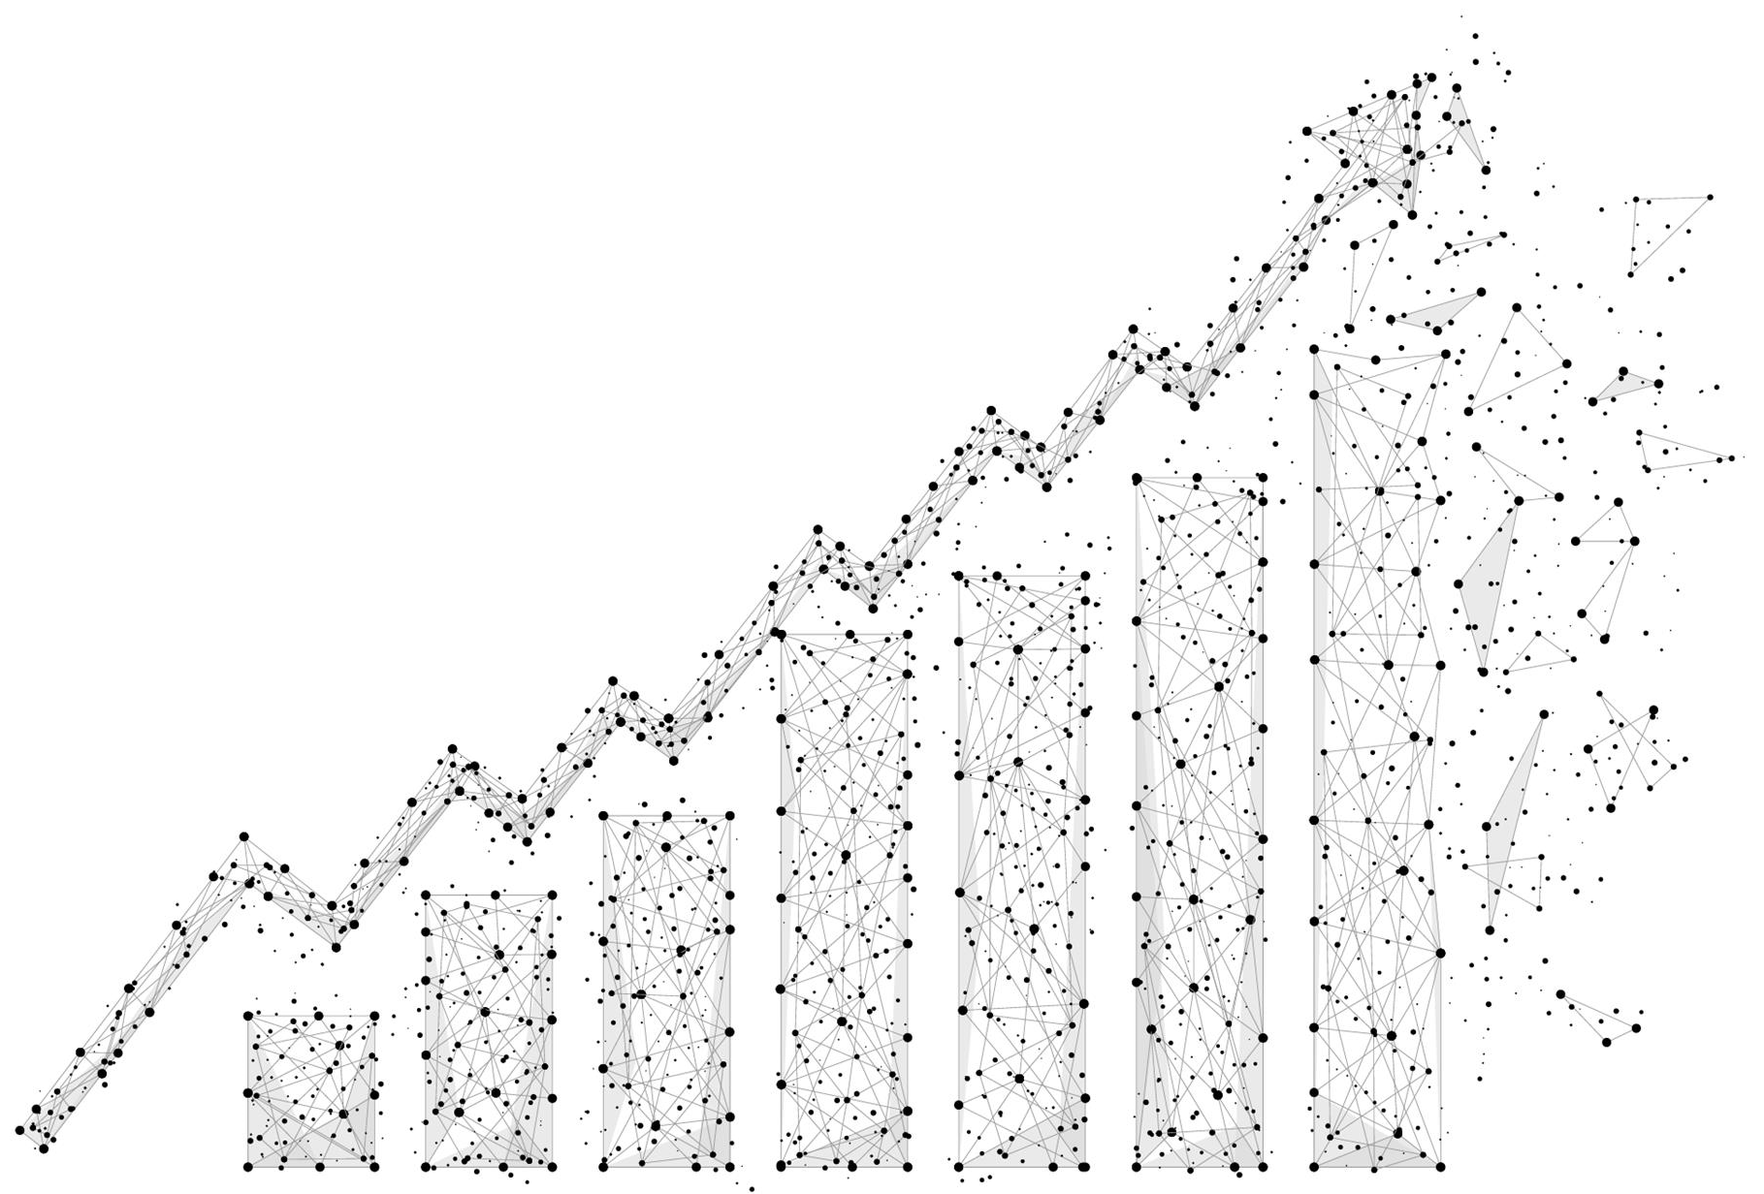
Real challenge
IoT Data
50 TB Initial Load
20 GB Daily Load (Batch Mode)
Wide Spectrum of Query Analysis
Detailed Queries (Point Queries)
Queries with lot of aggregations
Full scan queries
OLAP Cubes

Slide 6
Challenge
How to choose proper
query execution engine?
Theory…

Slide 7
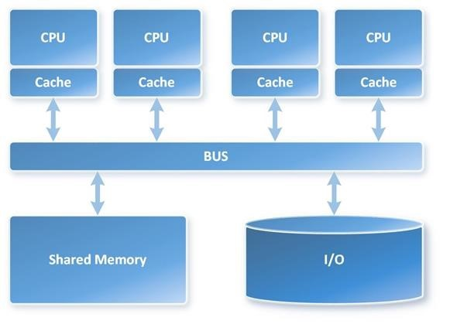
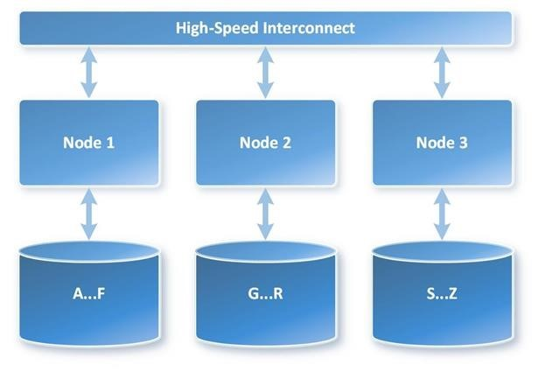
SMP vs MPP
Symmetric Multi Processing (SMP)
Massively Parallel Processing (MPP)

Slide 8
Relational Databases and Non-Relational Databases (NoSQL Databases)
Relational Databases
(+) Relational databases work with structured data.
(+) Support ACID transactional consistency
(-) Data is normalized, meaning lots of joins, which affects speed.
(-) Problems working with semi-structured data
Non-relational/NoSQL
(+) Schema-free or Schema-on-read options
(+) Work with unstructured and semi-structured data
Weaker or eventual consistency (BASE / CAP) instead of ACID
(-) No Standard SQL support
Notes:
(Basically Available, Soft state, Eventual consistency)

Slide 9
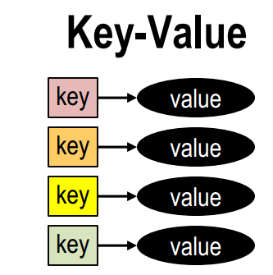
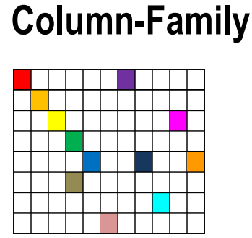
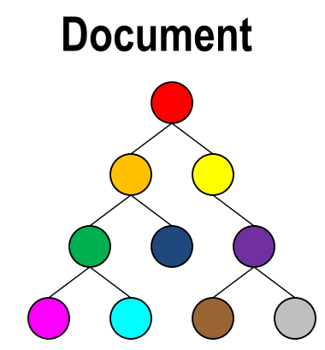
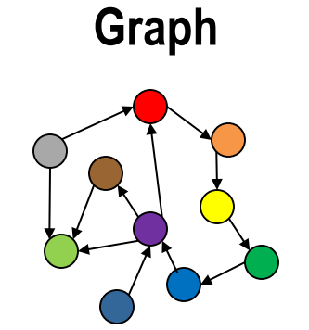
NoSQL Databases Categories
Key-Value Stores
Document Stores
Wide-Column Stores
Graph
Source:DataVersity

Slide 10
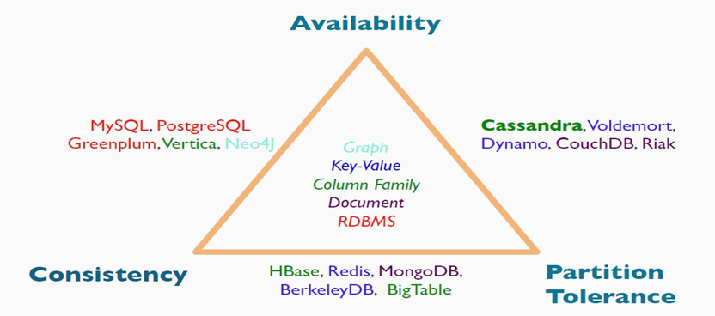
Databases (CAP)
Source:https://www.quora.com/HBase-follows-which-features-of-CAP-theorem

Slide 11



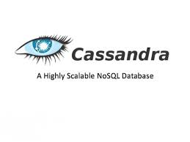



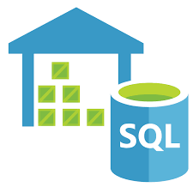





Database solutions
Azure Data Warehouse

Slide 12
Detailed Queries (Point Queries)
Client Application
Interactive Query Engine
SELECT READINGDATETIME,VALUE
FROM DEVICESDATA
WHERE
DEVICEID = 86
AND READINGDATETIME>'2018-09-01'
ORDER BY READINGDATETIME LIMIT 1000

Slide 13
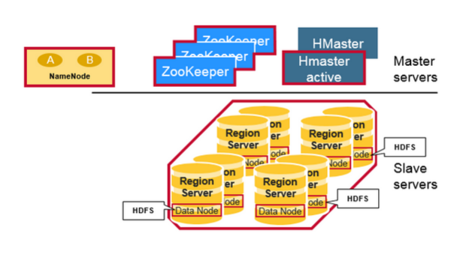
Apache HBase
Built on Hadoop
Master/slave
On top of HDFS
Implementation of Google BigTable
Column-oriented key-value data store
Sharding (region)
Random access and strong consistency
Schemaless
Scales linearly to handle petabytes
of data on thousands of nodes

Slide 14
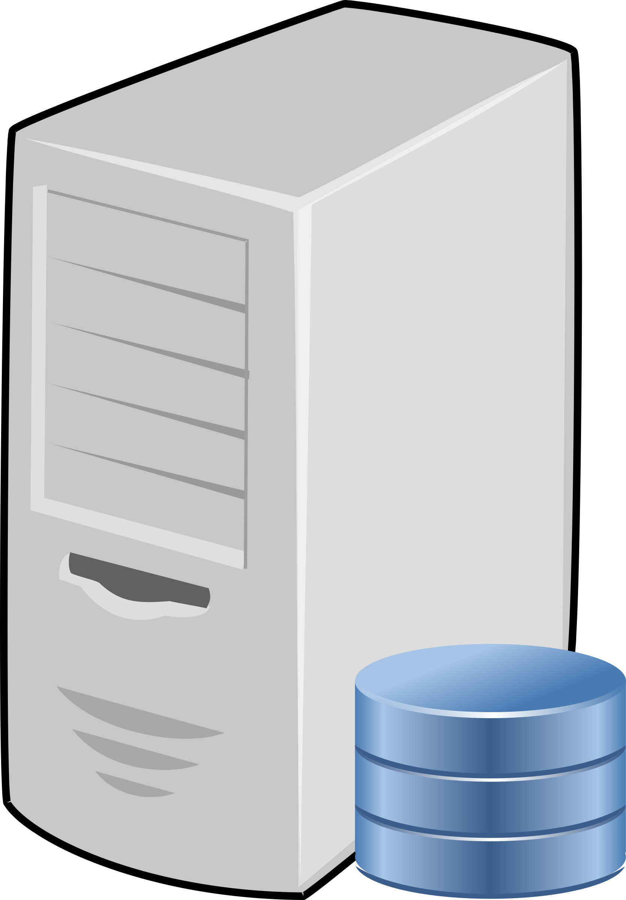
Apache HBase (horizontal sharding)
Table
Regions (key ranges)
HFile
Region servers
RowKey | CF1 |  | CF2
 | ColA | ColB | ColA | ColB
1 |  | val
2 | val | val | val | val
3 | val | val | val | val
4 | val | val |  | val
5 | val |  |  | val
6 | val |  | val
1 |  | val
2 | val | val | val | val
1 |  | val
2 | val | val
1
2 | val | val
3 | val | val | val | val
4 | val | val |  | val
3 | val | val
4 | val | val
3 | val | val
4 |  | val
5 | val |  |  | val
6 | val |  | val
5 | val
6 | val
5 |  | val
6 | val

Slide 15
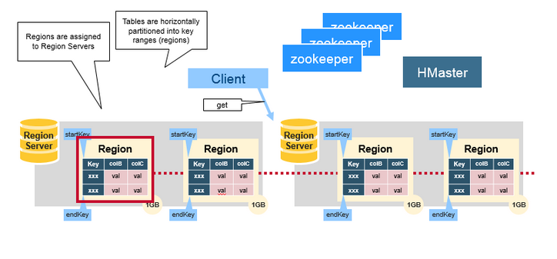
Apache HBase (Architecutre)

Slide 16
Apache Phoenix
„Phoenix Puts the SQL Back in NoSQL”
Phoenix
SQL Layer for HBase
JDBC/ODBC driver
SQL (SELECT, FROM, WHERE, HAVING, GROUP BY)
SALT_BUCKETS / SPLIT ON
Secondary Indexes
Join
Row timestamp
Transactions
User-defined Functions
…

Slide 17
DEMO

Slide 18
Data warehouse and Data Lake
What is Data Lake ?
“If you think of a datamart (a subset of a data warehouse) as a store of bottled water – cleansed and packaged and structured for easy consumption – the data lake is a large body of water in a more natural state„
Pentaho CTO James Dixon

Slide 19
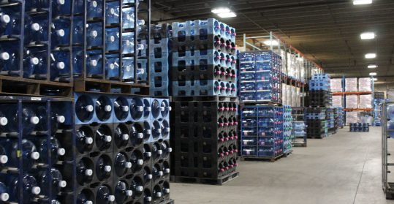

Data warehouse and Data Lake
Source: https://premiumwaters.com
Source :https://snowbrains.com

Slide 20

Interactives queries on Data Lake
Social
Devices
Batch queries
Video
Sensors
LOB applications
Web
Interactive queries

Slide 21
Big Data Interactive Queries Challenges
COSTS
Query Performance
Query Concurrency
Data Volume (Scale)

Slide 22
Interactives queries on Data Lake
Interactive Query Engine
Client Application
SELECT DEVICEID, AVG(VALUE) AVGVAL
FROM DEVICESDATA
WHERE
READINGDATETIME >= '2018-08-01'
AND READINGDATETIME <= '2018-08-31'
GROUP BY DEVICEID
Social
Devices
Video
Sensors
LOB applications
Web

Slide 23

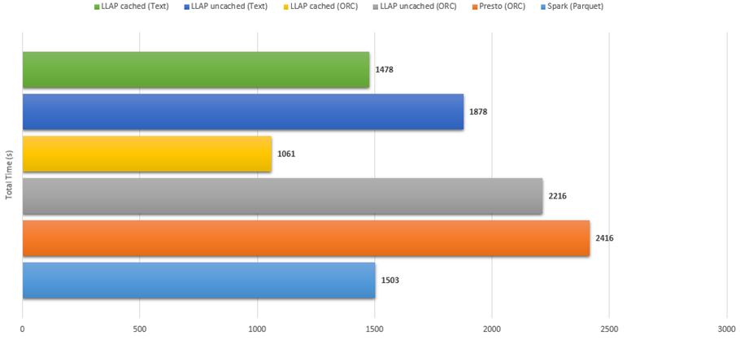


Hive LLAP, Spark, Presto…
Azure HDInsight Performance Benchmarking: Interactive Query, Spark and Presto

Slide 24
Spark
Apache Spark™ is a unified analytics engine for large-scale data processing.
It was originally developed at UC Berkeley in 2009.
Apache Spark is a fast, in-memory data processing engine
Simplified Developer APIs: Scala,Python, R, SQL
Spark SQL
Interactive queries
Spark Streaming
Stream processing
Spark MLlib
Machine learning
GraphX
Graph computation
Spark core engine
YARN
Mesos
Standalone scheduler
HDFS
Azure Blob Storage/Data Lake Store

Slide 25

What makes Spark fast?
In-memory data sharing between steps of a job
Reads from HDFS
Writes to HDFS
Reads from HDFS
Writes to HDFS
In traditional MapReduce
Step 1
Step 2
Reads and writes
from HDFS
In Spark
Step 1
Step 2
100x faster than MapReduce

Slide 26

Spark SQL
Part of the core distribution since Spark 1.0 (April 2014)
Runs SQL / HiveQL queries, optionally alongside or replacing existing Hive deployments
DataFrames and SQL share the same optimization/execution pipeline (Catalyst)
Using RDD
data = sc.textFile(...).split("\t")
data.map(lambda x: (x[0], [int(x[1]), 1])) \
.reduceByKey(lambda x, y: [x[0] + y[0], x[1] + y[1]]) \
.map(lambda x: [x[0], x[1][0] / x[1][1]]) \
.collect()
Using SQL
SELECT name, avg(age)
FROM people
GROUP BY name

Slide 27
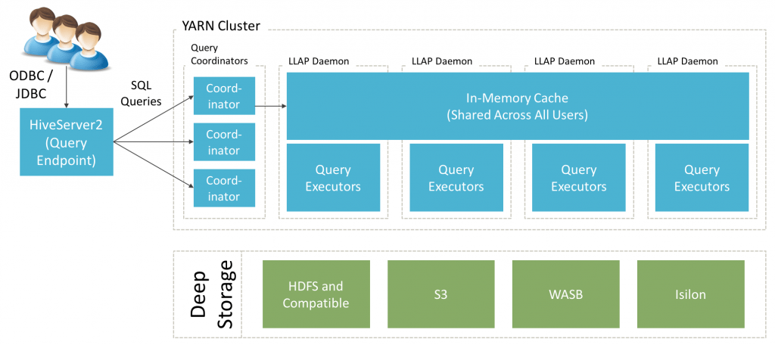
Hive and Hive LLAP (Live Long And Process)
The Apache Hive ™ data warehouse software facilitates reading, writing, and managing large datasets residing in distributed storage using SQL.
Live Long And Process (LLAP) functionality was added in Hive 2.0
Not another "execution engine" (like MR, Tez )
Hybrid model combining daemons and containers for fast, concurrent execution of Hive SQL queries
Advanced Caching
Source : Hortonworks
Notes:
Facebook, Apache Hive is used and developed by other companies such as Netflix
Live Long And Process
Batch model
LLAPInteractive Queries

Slide 28
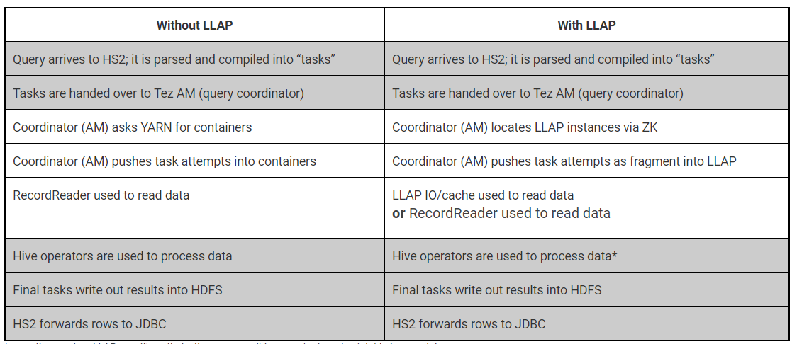
Hive and Hive LLAP (Live Long And Process)
Source : Hortonworks

Slide 29
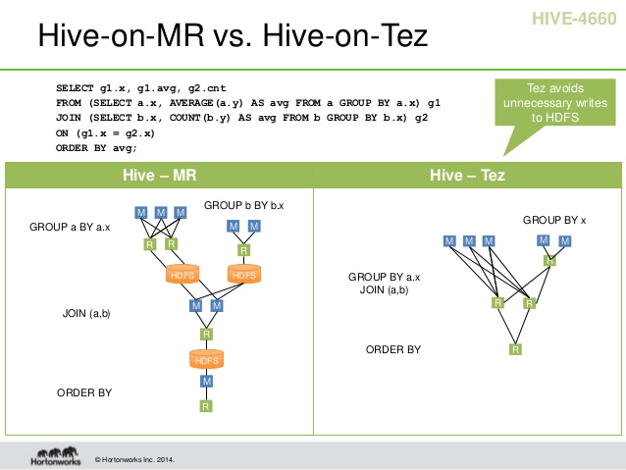
Hive and Hive LLAP (Live Long And Process)

Slide 30






Azure Solutions
Client Application
Simba Spark ODBC Driver
Microsoft Hive ODBC Driver
Read/Write
Read/Write
Azure Data Lake Store
Azure Databricks
Azure HDInsight Interactive Query Cluster
Metastore

Slide 31
DEMO

Slide 32
Q & A

Slide 33
Resources
https://community.hortonworks.com/articles/149894/llap-a-one-page-architecture-overview.html
https://cwiki.apache.org/confluence/display/Hive/LLAP

Slide 34
THANK YOU!
tkrawczyk@future-processing.com
szederowski@future-processing.com

